Slide 1

Cyber Threat Detection
Veronica Chan
Springboard Data Science Intensive Capstone Project
May 2, 2025

Slide 2

Problem Statement
Using a cyber activity dataset to train a machine learning model to identify and classify various types of cyber threats based on network traffic data and textual content.
The dataset contains a comprehensive collection of data for detecting, diagnosing, and mitigating cyber threats using network traffic data, textual content, and entity relationships.

Slide 3
Data Information
Cyber Threat Dataset: Network, Text & Relation
Source: https://www.kaggle.com/datasets/ramoliyafenil/text-based-cyber-threat-detection
File Format: CSV
Data acquired for 2023
Number of records: 19940
Number of fields: 8
Each record contains a label with textual content related to cyber activity

Slide 4

Data Analysis

Slide 5
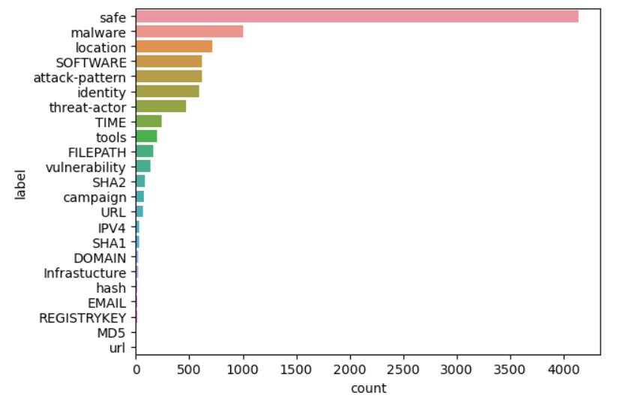
Majority of the data is safe, there are 1003 occurrences of malware, 617 occurrences of attack-pattern, and 466 occurrences of threat-actor. The data appears to be imbalanced.

Slide 6
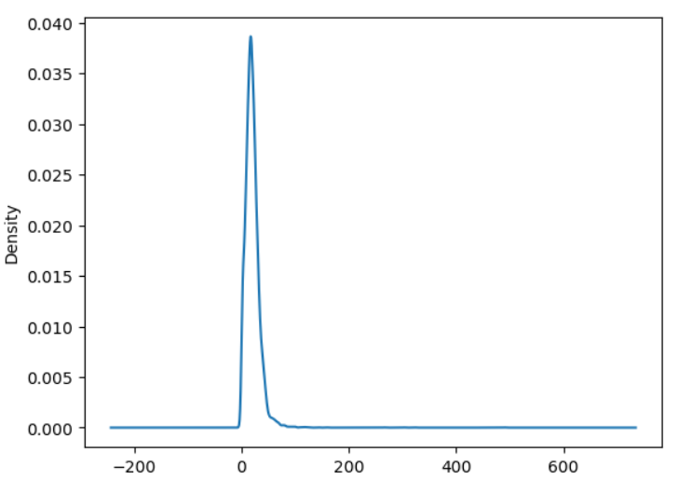
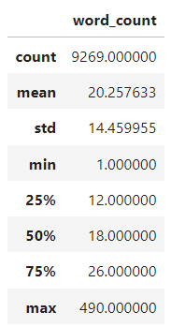
There is a total of 187,768 words and on average the word count is around 20 words for each text. The label with the most words is ‘tools’ with max 490 words in a text. Majority of the text data falls between 1-100 words.

Slide 7
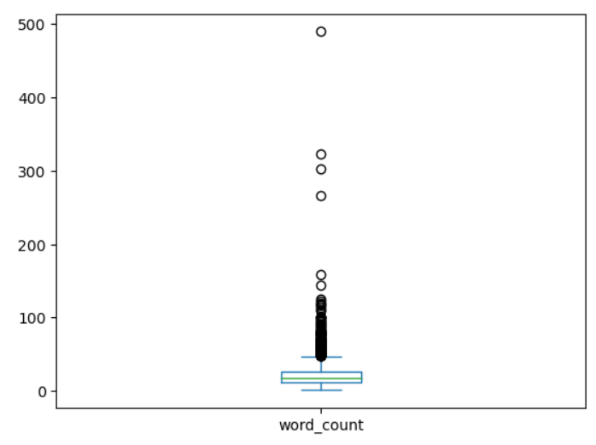
Further checking the word count data, there are a few outliers with very high word count to 490 words, some with range 275 to 350 words.

Slide 8
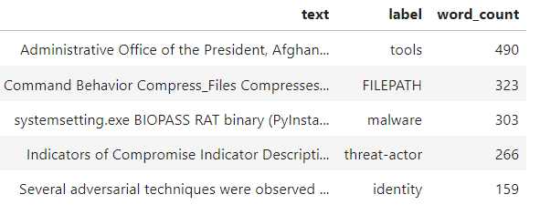
The top 5 rows with the longest word count:

Slide 9
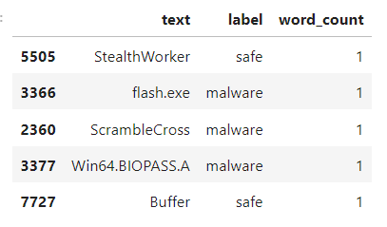
The top 5 rows with the shortest word count:

Slide 10
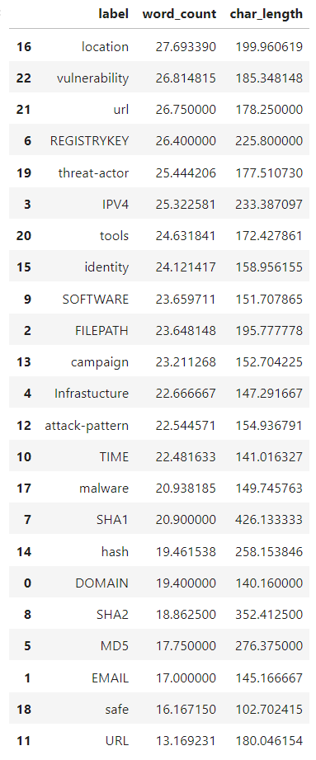
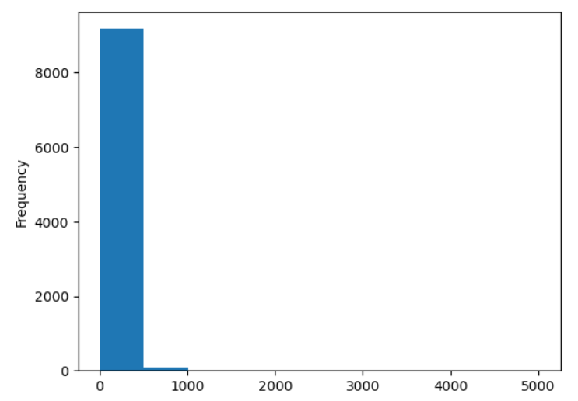
Checking the frequency of the character length, it shows similar results as the word length, majority of the data ranging between 1 to 500 characters long.

Slide 11
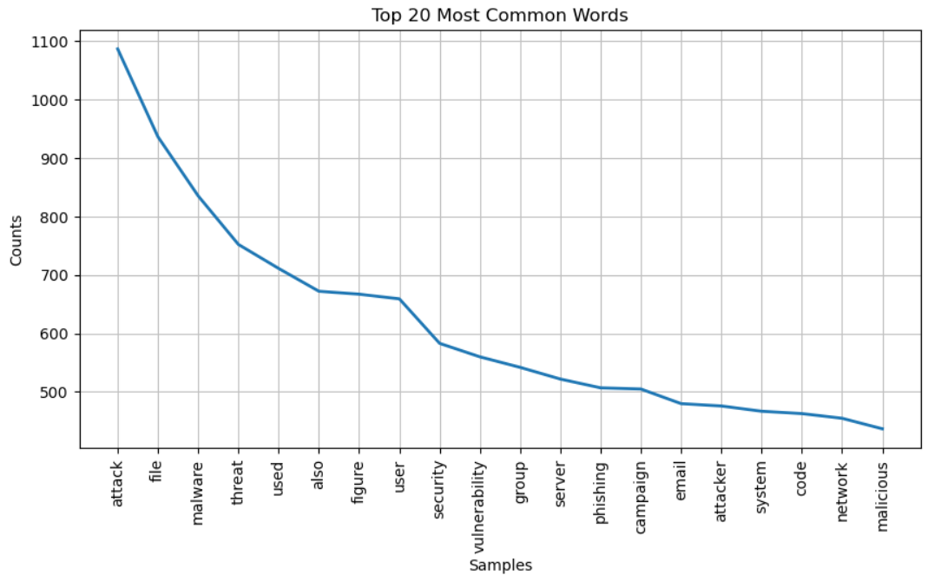

Slide 12
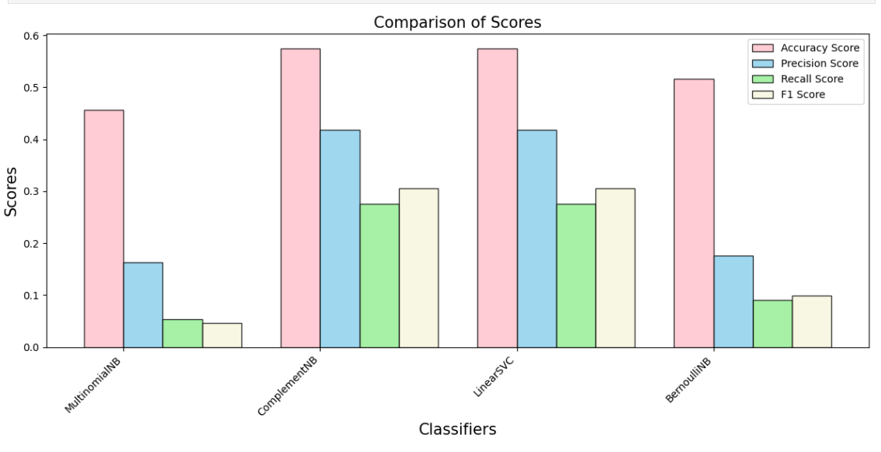
MultinomialNB: Lowest accuract score, precision score, recall score, and F1-score. ComplementNB & LinearSVC: Identical accuracy score, precision score, recall score, and F1-score. BernoilliNB: Slightly lower accuracy score but comparable precision score, recall score, and F1-score to ComplementNB and LinearSVC. Overall, ComplementNB and LinearCSV performed the best. I will next tune hyperparameters to further improve the performance of both models.

Slide 13
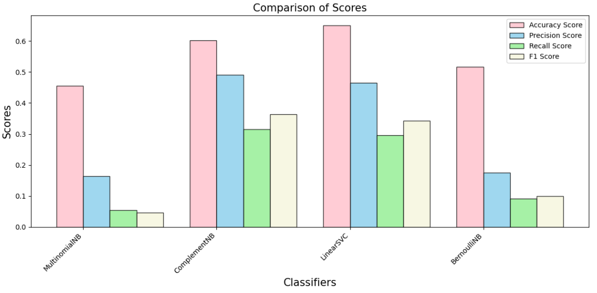
After hyperparameter tuning, it did increase the performance of both ComplementNB and LinearSVC. LinearSVC: Highest accuracy score and precision score overall. ComplementNB: Highest precision score but lower accuracy score than LinearSVC. BernoulliNB: Lowest scores overall. LinearSVC seems to be the best performing model. We will use this model to test new data to see if it can accurately predict labels for the given textual content.

Slide 14
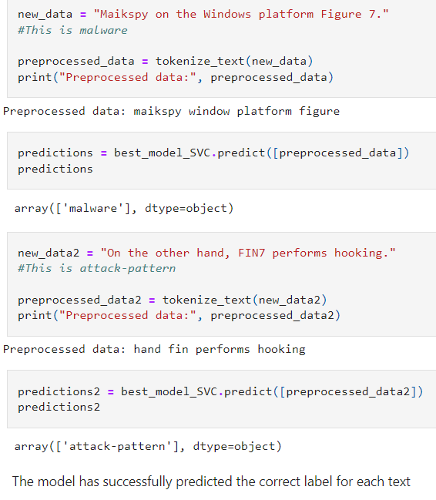

Slide 15
Future Work
Introduce additional cyber activity data and retrain the model to perform even better.
Train the model to also produce recommended solutions along with the predicted labels.

Slide 16

Thank You
Veronica Chan
Email: veronica.chan143@yahoo.com
LinkedIn: https://www.linkedin.com/in/veronica-chan-4712a21b2
GitHub Repo: https://github.com/vchan022/Capstone-3-Cyber-Threat-Detection

